Slide 1

Hybrid Cryptography for connected wireless devices
Introduction
2
Related
Works
3
Research Methodology
1
4
Results
5
6
Conclusion
References
“With the growth in IOT,Cloud computing, etc. security is at a risk.
The Greatest security control you can deploy is cryptography.”
A project by Vaidehi Manoj Ghime.
Department Of Computer Science And Engineering,
Indian Institute Of Information Technology,Nagpur.

Slide 2
Introduction:
Limited energy, computational and memory resources.
Cryptography Algorithms require high computational power.
Hybrid Cryptography combines:
convenience of public key cryptosystem.
efficiency of the symmetric key cryptosystem.
main aim is to provide an efficient algorithm for Secure Data Communication using minimum memory and power.

Slide 3

Session key generated by one party.
Public Key of the Recipients
Network
Sender
Session Key encrypted
by public key
Plain Text (Message)
Plain Text is encrypted using session key and is sent on the network

Slide 4
Packet
Cipher Key
Cipher Message
Message
Actor
(Recipients)
Has
The Cipher Message decrypted using the session key
Has
Session Key
Private Key
The Cipher Key decrypted
using the private key

Slide 5
Related Works:
Author (Year) | Proposed Approach
Prakash, S., & Rajput^{[1]} (2018) | An Efficient Algorithm exploiting the advantages of AES -symmetric key algorithm and ECC- asymmetric key algorithm consuming less resources and time.
Verma, S., & Garg, D.^{[2]} (2014) | reduce the memory requirement of RSA cryptosystem so as to use RSA in memory constrained environment.
Mahalle, V. S., & Shahade, A. K.^{[5]} (2014) | proposed a hybrid encryption algorithm using RSA and AES algorithms for providing data security to the user in the Cloud. The biggest advantage it provides us is that the keys are generated on the basis of system time and so no intruder can even guess them there by giving us increased security along with convenience

Slide 6
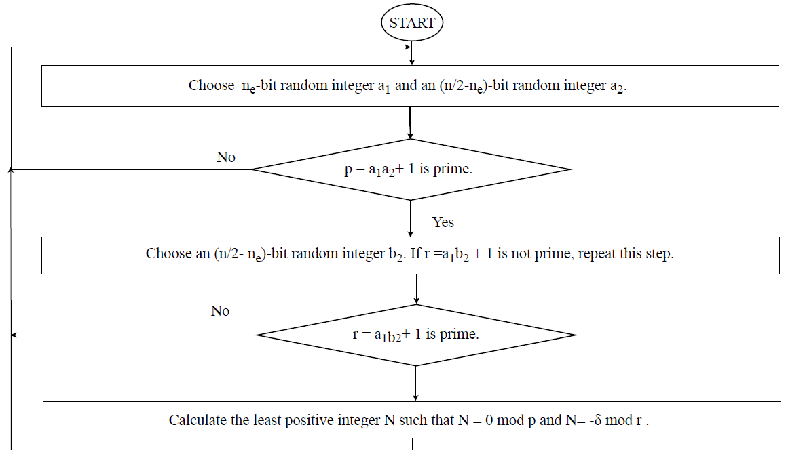
Research Methodology:

Slide 7
Public Key
Message (Plain text)
Session Key
AES Algorithm
Cipher Key=
(Session Key)^{e} mod N
Cipher Text
Cipher Key

Slide 8
Results:
As the user/devices increases the no of keys increases linearly and not exponentially.
One of the most secure Cryptographic algorithm cannot be broken by today’s Supercomputers too.
Data Confidentiality, Integrity.
Encryption and decryption is not complex due to use of AES and does not consumes time.
Succeeded to bring an memory and time efficient cryptographic algorithm .

Slide 11
Conclusion:
scope of wireless devices ,cloud based services is increasing.
need to provide secure data communication with the use of limited resources.
used the advantages of RSA algorithm for key generation and sharing and AES algorithm for encryption and decryption.
RSA algorithm is modified to the memory efficient version.

Slide 12
References:
Prakash, S., & Rajput, A. (2018). Hybrid Cryptography for Secure Data Communication in Wireless Sensor Networks. Springer Nature Singapore Pte Ltd. 2018,589-599. Retrieved April 9, 2018.
Verma, S., & Garg, D. (2014). RSA Variant with Efficient Memory Usage. International Conference on Advances in Engineering and Technology (ICAET2014) March 29-30, 2014 Singapore,209-211. doi:10.15242/iie.e0314095.
Thirumalai, C., & Kar, H. (2017). Memory efficient multi key (MEMK) generation scheme for secure transportation of sensitive data over cloud and IoT devices. 2017 Innovations in Power and Advanced Computing Technologies (i-PACT). doi:10.1109/ipact.2017.8244948.
Najar, J. M., & Dar, S. B. (2014). A New Design Of A Hybrid Encryption Algorithm. International Journal Of Engineering And Computer Science,3, 9169-9171. doi:11 November
Mahalle, V. S., & Shahade, A. K. (2014). Enhancing the data security in Cloud by implementing hybrid (Rsa & Aes) encryption algorithm. 2014 International Conference on Power, Automation and Communication (INPAC). doi:10.1109/inpac.2014.6981152

